Slide 1
SDG Analysis Process
Workshop
[PLACE AND TIME]

Slide 2
Content of workshop
We also will hold a couple short breaks during the workshop
At XX: Objective of workshop and introduction to the theme
Objective
Introductions
The 17 Sustainable Development Goals
At XX: Work in the workshop
Instructions for work
Work
Summary discussion
At XX: The event ends

Slide 3
Workshop objectives
Objectives today - lessons for participants
Lessons and understanding on the Sustainable Development Goals
Links between the SDGs and the topic to be examined and one’s own work
Shared ideas and tools for promoting the SDGs in the future

Slide 4
Introductions

Slide 5
The 17 Sustainable Development Goals
AGENDA 2030

Slide 6
Terminology
Sustainable development Sustainable development refers to development that secures good living conditions and possibilities for current and future generations within the limitations of the planet’s carrying capacity.
SDG Sustainable Development Goal.
Agenda 2030 The UN global agenda for sustainable development, which comprises 17 Sustainable Development Goals, which are further divided into 169 targets.
SDG Analysis Process An interactive workshop method the aim of which is to increase SDG expertise and the ability to understand and the desire to act for the promotion of the Sustainable Development Goals. The method was developed specifically for the needs of cities.

Slide 7
Dimensions of sustainable development
Economic sustainability
Social sustainability
Ecological sustainability
Cultural sustainability

Slide 8
Global problem, shared goals
The UN’s Agenda 2030 goals are the same for all the world’s countries, and nearly all countries have committed to these
Each country’s starting point is unique
Rich countries are tasked with not only progressing towards achieving the goals themselves, but also facilitating their implementation in developing countries
The promotion of all the goals is important: sustainable development is not only climate or environmental action

Slide 9
From the global to the local level
It is essential in the promotion of the SDGs that the relevant goals are identified and global goals are localised.

Slide 10
17 SDGs
1 No poverty
2 Zero hunger
3 Good health and well-being
4 Quality education
5 Gender equality
6 Clean water and sanitation
7 Affordable and clean energy
8 Decent work and economic growth
9 Industry, innovation and infrastructure
10 Reduced inequalities
11 Sustainable cities and communities
12 Responsible consumption and production
13 Climate action
14 Life below water
15 Life on land
16 Peace, justice and strong institutions
17 Partnerships for the goals

Slide 11
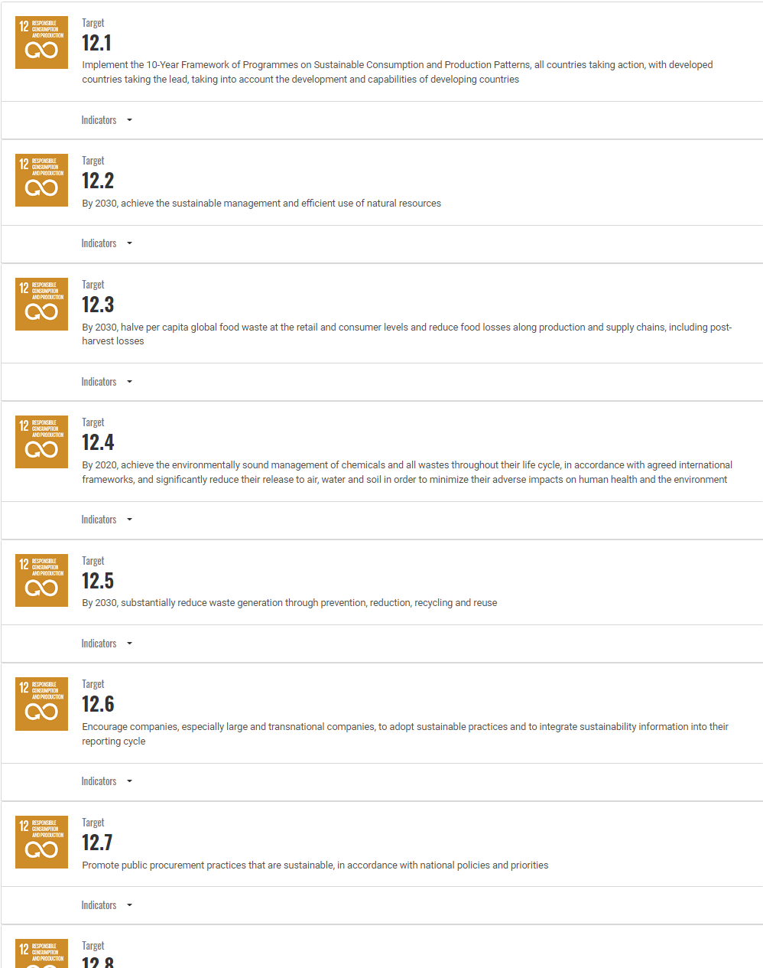
169 targets
The 17 goals are divided into 169 targets
Source of image: UN

Slide 12
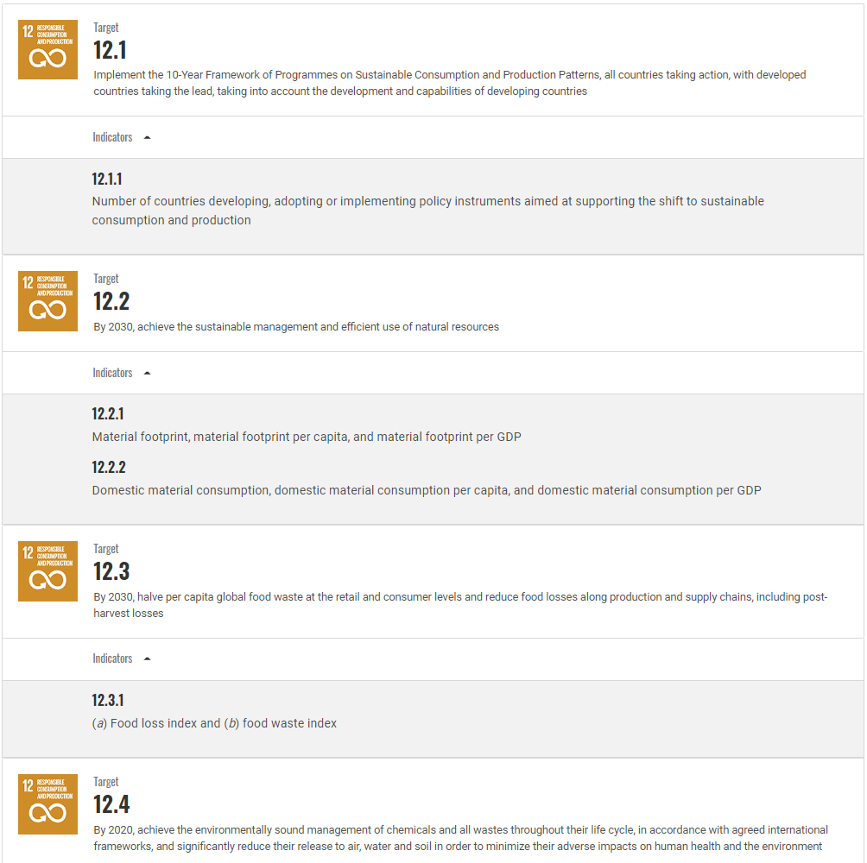
The goals are measured with a group of indicators
Sources of images: UN

